Slide 1
Foundation Course

Slide 3
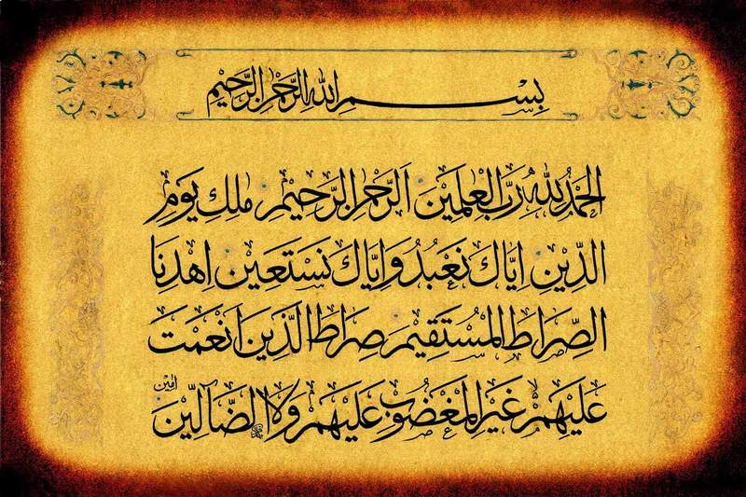

Slide 4
Welcome
To
All participants of foundation course
From
F.M.D

Slide 5
INTRODUCTION
Course leader
And
Course participants

Slide 6
Foundation Course
Day 1

Slide 7
INTRODUCTION
OF
CORPORATION

Slide 8
A BRIEF HISTORY
OF
STATE LIFE INSURANCE
CORPORATION
OF
PAKISTAN

Slide 9
NATIONALIZATION
OF LIFE INSURANCE
The life insurance business in Pakistan was nationalized under a Presidential Order on 19th March 1972. It was executed in two stages. In the first stage which covered the period 19th March to 31 October 1972, the management of 32 life insurance companies were taken over by the government. Trustees and sub-trustees were appointed by the Government to takeover different companies and to co-ordinate and guide their activities.

Slide 10
NATIONALIZATION
OF LIFE INSURANCE
The Government constituted Life Insurance Management Board (LIMB). The Board’s term included the task of recommending a permanent set up of life insurance within the framework of nationalization. The Board recommended establishing a single corporation with three units.

Slide 11
NATIONALIZATION OF LIFE INSURANCE
The second phase of nationalization started by establishment of Single Corporation called State Life Insurance Corporation of Pakistan with 3 Units called A, B, and C operating throughout Pakistan and competing with one another.
On 1st October 1975, the 3 Units merged and different Zones were created. Initially there were five Zones with their Zonal offices at Karachi, Hyderabad, Lahore, Rawalpindi and Peshawar. The figure has increased to 26 Zones under four different Regions, South, Central, North and Multan headed by very competent Executives.

Slide 12
NATIONALIZATION
OF LIFE INSURANCE
By the Grace of Allah the Almighty, State Life has made steady progress in all fields of its operations. The future is even brighter as the Corporation is making very positive strategies for not only maintaining its market leadership but displaying beyond any doubt that it deserves the matchless corporate image created during the last decades.

Slide 13
OBJECTIVES
To run life insurance business on sound lines.
To provide more efficient service to the policyholders.
To maximize the return to the policyholder by economizing expenses and increasing the yield on investment.
To make life insurance a more effective means of mobilizing national savings.
To widen the area of operation of life insurance and make it available to as large a section of the population as possible, extending it from the comparatively more affluent sections of society to the common man in towns and villages.
To use the policyholder’s fund in the wider interest of the community

Slide 14
MISSION STATEMENT
“To remain the leading insurer in the country by extending the benefits of life insurance to all sections of society and meeting our commitments to our policyholders and the nation.”
QUALITY POLICY
To ensure satisfaction of our valued policyholders in processing new business, providing after sales service and optimizing return on life fund through a quality culture and to maintain our position as the leading life insurer in Pakistan.

Slide 15
ORGANIZATIONAL STRUCTURE

Slide 16
ORGANIZATIONAL CHART
PRINCIPAL OFFICE
CHAIRMAN
Executive Director
Executive Director
Executive Director
Executive Director
Divisional Head Actuarial
Divisional Head Marketing
Divisional Head Finance & Accounts
Divisional Head Group & Pension
Divisional Head Personal & General Services
Divisional Head Corporate Affairs
Divisional Head Real Estate Operation
Divisional Head Real Estate Inspection & Evaluation
Divisional Head Legal affairs
Divisional Head Research and Analysis
Divisional Head P.H.S Inspection & Evaluation
Divisional Head P.H.S Operation
Divisional Head Information Technology
Divisional Head Internal Audit and Compliance
Divisional Head Investment
Bancassurance Cell

Slide 17
CORPORATE MARKETING STRUCTURE
INDIVIDUAL LIFE
&
GROUP LIFE
4 Regions Individual Life
26 Zones Individual Life
4 Zones Group Life
Gulf Zone Individual Life

Slide 18
CORPORATE MARKETING STRUCTURE
SOUTHERN REIGON
Karachi Southern Zone
Karachi Eastern Zone
Karachi Central Zone
Hyderabad Zone
Mirpurkhas Zone
Sukkur
Zone
Quetta Zone
Larkana Zone

Slide 19
CORPORATE MARKETING STRUCTURE
CENTRAL REGION
Lahore Zone Central
Lahore Zone Western
Faisalabad Zone
Sargodha Zone
Gujranwala Zone
Sialkot Zone

Slide 20
CORPORATE MARKETING STRUCTURE
NORTHERN REGION
Rawalpindi Zone
Mirpur (A.K) Zone
Islamabad Zone
Peshawar Zone
Abbottabad Zone
Swat Zone
Gujrat

Slide 21
CORPORATE MARKETING STRUCTURE
MULTAN REGION
Multan Zone
Sahiwal Zone
Rahimyar Khan Zone
D.G.Khan Zone
Bhawalpur Zone

Slide 22
CORPORATE MARKETING STRUCTURE
GROUP LIFE ZONES
Karachi Zone
Lahore Zone
Rawalpindi Zone
Peshawar Zone

Slide 23
CORPORATE MARKETING STRUCTURE
GULF ZONE
United Arab Emirates
Kuwait
Kingdom Of Saudi Arabia
Abu Dhabi
Jeddah
Dubai
Riyadh

Slide 24
MARKETING FORCE STRENGTH AS ON 30.11.2010
Sector Offices 189
Area Offices 710
Sales Managers 4,277
Sales Officers 11,322
Sales Reps 93,551

Slide 25
STATE LIFE
OWNED
COMMERCIAL BUILDINGS

Slide 26
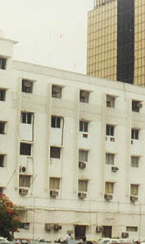
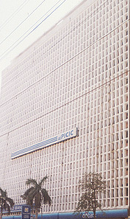
KARACHI
STATE LIFE BUILDING NO. #1A, 1B & IC
I.I. Chundrigar Road
STATE LIFE BUILDING NO. 1& Annex
I.I. Chundrigar Road

Slide 27
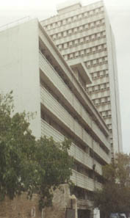
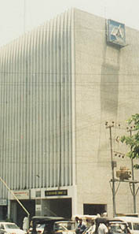
KARACHI
STATE LIFE BUILDING NO. 2, 2A & 2B
Wallace Road
STATE LIFE BUILDING NO. 3
Dr. Ziauddin Ahmed Road

Slide 28
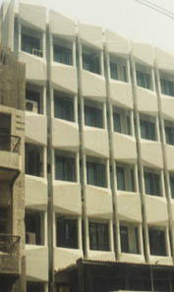
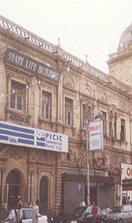
KARACHI
STATE LIFE BUILDING NO. 4
Shahreh Liaquat
STATE LIFE BUILDING NO. 5B
Zaibunnissa Street, Saddar

Slide 29
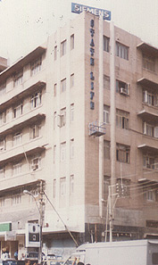
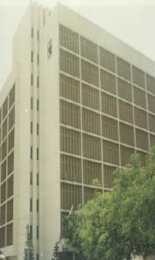
KARACHI
STATE LIFE BUILDING NO. 5 & 5A
Abdullah Haroon Road
STATE LIFE BUILDING NO. 9 , Principal Office,
Dr. Ziauddin Road

Slide 30
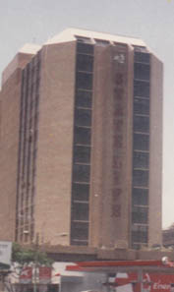
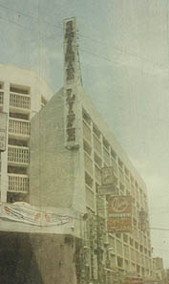
KARACHI
STATE LIFE BUILDING NO. 11
Abdullah Haroon Road
STATE LIFE BUILDING NO. 12
Abdullah Haroon Road

Slide 31
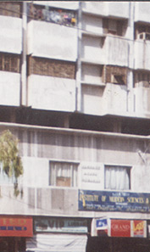
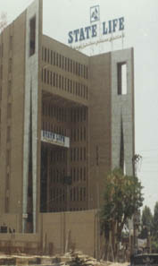
HYDERABAD
GUL CENTER
164 Hyderabad Cantt
STATE LIFE BUILDING
NO. 50 Thandi Sarak
Hyderabad

Slide 32
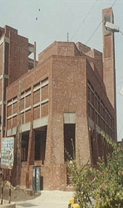
MIRPURKHAS
STATE LIFE BUILDING
Mirpurkhas

Slide 33
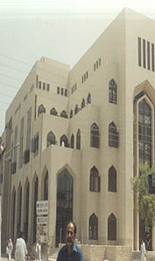
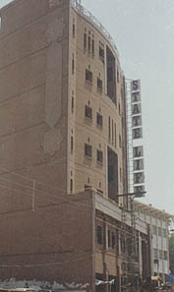
LARKANA AND SUKKUR
STATE LIFE BUILDING
Quaid-e-Awam Road
Larkana
STATE LIFE BUILDING
Minara Road
Sukkur

Slide 34
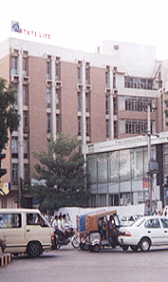
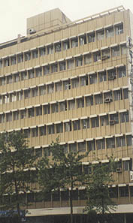
MULTAN AND RAWALPINDI
STATE LIFE BUILDING
Chowk Nawan Shahar
Multan
STATE LIFE BUILDING
NO. 1 ,The Mall
Rawalpindi

Slide 35
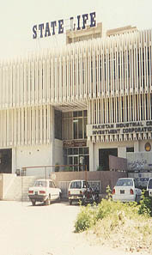
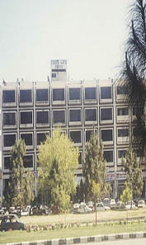
ISLAMABAD
STATE LIFE BUILDING
Plot NO. 7 - (Phase-1) Blue Area - Islamabad
STATE LIFE BUILDING
No. 9, 33-E , Buland Markaz
Islamabad

Slide 36
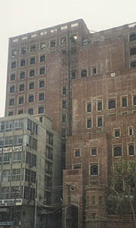
FAISALABAD
STATE LIFE BUILDING
No. 2 Liaquat Road
Faisalabad

Slide 37
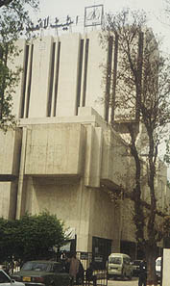
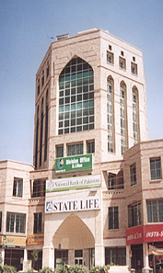
PESHAWAR & D.I. KHAN
STATE LIFE BUILDING
NO. 1 The Mall Peshawar
STATE LIFE BUILDING
63-p Circular Road
Dera Ismail Khan

Slide 38
PROJECTS IN PLANNING
OR
UNDER CONSTRUCTION
ISLAMABAD 01
GUJRANWALA 01
SIALKOT* 01
SARGODHA* 01
RAHIMYAR KHAN* 01
SAHIWAL* 01
TOTAL 06
*PROJECTS IN PLANNING

Slide 39
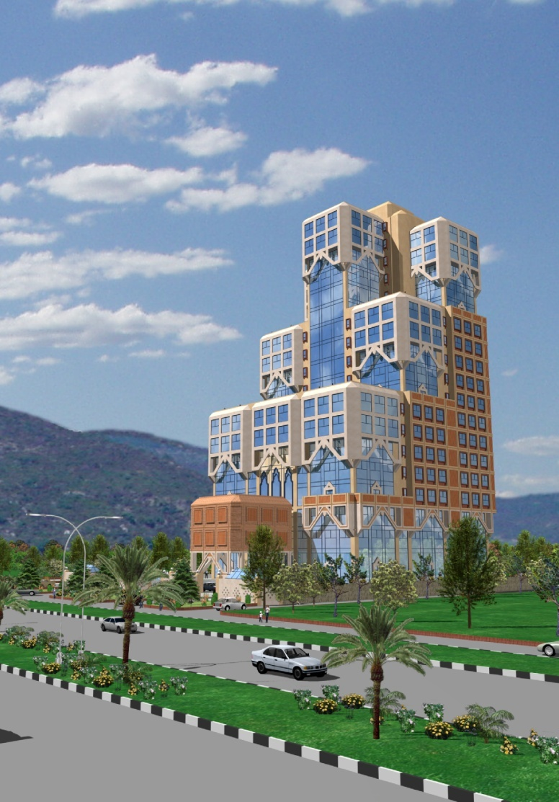
STATE LIFE TOWER ISLAMABAD
BUILDING COMPRISES OF
3 BASEMENTS
+ GROUND FLOOR
+ 18 UPPER FLOORS

Slide 40
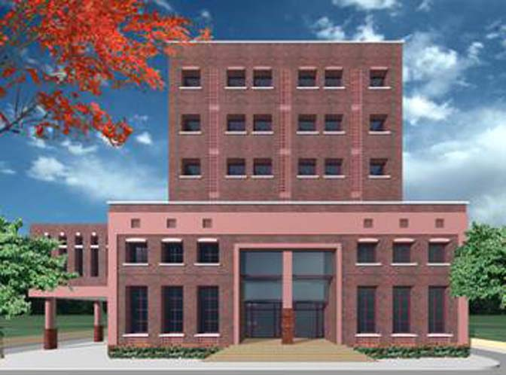
STATE LIFE BUILDING GUJRANWALA
BUILDING COMPRISES OF BASEMENTS + GROUND FLOOR + 5 UPPER FLOORS

Slide 41
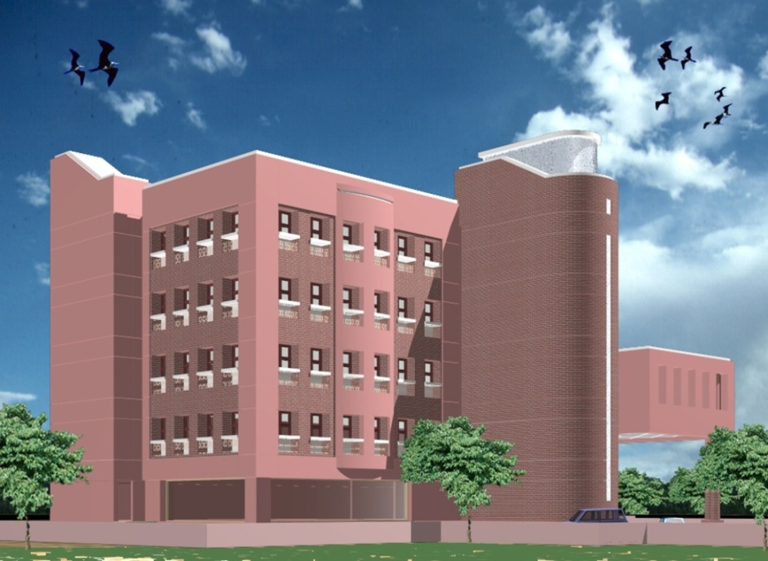
STATE LIFE BUILDING SARGODHA
BUILDING COMPRISES OF BASEMENTS + GROUND FLOOR + 4 UPPER FLOORS

Slide 42
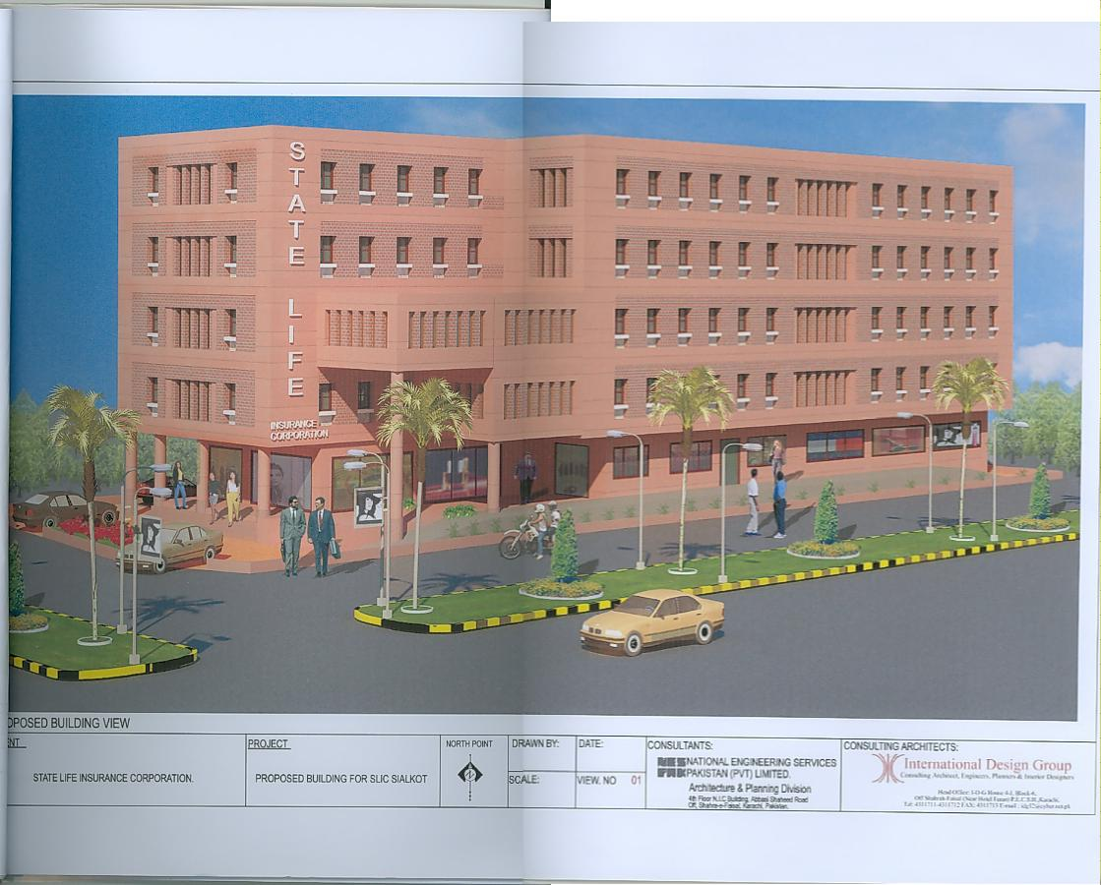
STATE LIFE BUILDING SIALKOT
BUILDING COMPRISES OF
BASEMENTS
+ GROUNDFLOOR
+ 4 UPPER FLOORS

Slide 43
COMMERCIAL BUILDINGS
S.#
City
No. of buildings
Inherited
Purchased Constructed
1. Karachi 22 17 05*
2. Hyderabad 03 01 02
3. Sukkur 01 00 01
4. Larkana 01 00 01
5. Mirpurkhas 01 00 01
6. Multan 01 00 01
7. Faisalabad 02 01 01
8. Lahore 09 07 02
9. Gujrat 01 00 01
10. RawalPindi 04 03 01
11. Islamabad 05 00 05
12. D.I.Khan 01 00 01
13. Peshawar 01 00 01
TOTAL 52 29 23
* One building owned by State Life Subsidiary

Slide 44
RESIDENTIAL BUILDINGS
S.#
City
No. of buildings
Inherited
Purchased
1. Karachi 09 07 02
2. Lahore 03 03 00
3. Quetta 0 00 01
Resorts and Hut 03 03 00
Total 16 13 03

Slide 45
DETAIL OF PLOTS
S.#
City
No. of buildings
Inherited
Purchased Constructed
Karachi 05 01 04*
Lahore 03 02 01
Islamabad 02 01 01
Mirpur ( A.K.) 02 00 02
Sahiwal 01 00 01
R.Y Khan 01 00 01
Sialkot 01 00 01
Nawab Shah 01 00 01
Gujranwala 01 00 01
Sargodha 01 00 01
TOTAL 18 04 14
* One plot owned by State Life Subsidiary

Slide 46
RENTING – COMMERIAL BUILDINGS
S.#
City
No. of buildings
Rentable area ( Sft)
Karachi 22 1,442,463
Hyderabad 03 136,192
Sukkur 01 20,560
Larkana 01 30,000
Mirpurkhas 01 35,815
Multan 01 29,006
Faisalabad 02 95,892
Lahore 09 333,821
Gujrat 01 70,500
RawalPindi 04 56,433
Islamabad 05 213,234
D.I.Khan 01 37,000
Peshawar 01 145,423
TOTAL 52 2,646,339 SFT

Slide 47
ACHIEVEMENTS

Slide 48
FIRST YEAR PREMIUM
IN MILLIONS (PKR)
SOURCE: 37th Annual Report 2009

Slide 49
RENEWAL PREMIUM IN MILLIONS (PKR)
SOURCE: 37th Annual Report 2009

Slide 50
GROUP LIFE PREMIUM
IN MILLIONS (PKR)
SOURCE: 37th Annual Report 2009

Slide 51
TOTAL PREMIUM IN MILLIONS (PKR)
SOURCE: 37th Annual Report 2009

Slide 52
LIFE FUND
IN MILLIONS (PKR)
SOURCE: 37th Annual Report 2009

Slide 53
YIELD ON LIFE FUND (%)
SOURCE: 37th Annual Report 2009

Slide 54
NO. OF INDIVIDUAL LIFE POLICIES INFORCE
SOURCE: 37th Annual Report 2009

Slide 55
BONUSES
(1977 TO 2009)

Slide 56
WHOLE LIFE – 1977 to 2000
Annual Reports

Slide 57
WHOLE LIFE – 2001 to 2008
Annual Reports

Slide 58
Endowment- 20 Years & above
1977 to 1998
Annual Reports

Slide 59
ENDOWMENT- 20 YEARS & ABOVE
1999 to 2009
Annual Reports

Slide 60
ENDOWMENT- 15 TO 19 YEARS
1977 to 1998
Annual Reports

Slide 61
ENDOWMENT- 15 TO 19 YEARS
1999 to 2009
Annual Reports

Slide 62
ENDOWMENT- 14 YEARS & LESS
1977 to 1998
Annual Reports

Slide 63
ENDOWMENT- 14 YEARS & LESS
1999 to 2009
Annual Reports

Slide 64
PERSISTENCY BONUS FROM THE 6TH POLICY YEAR ONWARD
1977 to 1988
Annual Reports

Slide 65
TERMINAL BONUS FOR EACH YEAR IN EXCESS OF 10 YRS. (MAX RS.800)
1977 to 1998
Annual Reports

Slide 66
TERMINAL BONUS FOR EACH YEAR IN EXCESS OF 10 YRS. (MAX RS.800)
1999 to 2009
Annual Reports

Slide 67
ANTICIPATED ENDOWMENT, 20 YEARS & ABOVE
1977 to 1998
Annual Reports

Slide 68
ANTICIPATED ENDOWMENT, 20 years & above
1999 to 2009
Annual Reports

Slide 69
ANTICIPATED ENDOWMENT, 15 TO 19 YEARS
1977 to 1998
Annual Reports

Slide 70
ANTICIPATED ENDOWMENT, 15 TO 19 YEARS
1999 to 2009
Annual Reports

Slide 71
ANTICIPATED ENDOWMENT, 14 YEARS & LESS
1977 to 1998
Annual Reports

Slide 72
ANTICIPATED ENDOWMENT, 14 YEARS & LESS
1999 to 2009
Annual Reports

Slide 73
WHOLE LIFE – 2001 to 2008
Annual Reports

Slide 74
OTHER BONUSES
ONE TIME BONUS
ONE TIME BONUS @Rs.40/- PER THOUSAND SUM ASSURED PAYABLE ON DEATH OR MATURITY TO ALL WITH PROFIT POLICIES INFORCE AS AT 31.12.94 AND OTHERWISE QUALIFIES
GOLDEN JUBILEE BONUS
GOLDEN JUBILEE BONUS @RS.50/- PER THOUSAND SUM ASSURED PAYABLE ON DEATH OR MATURITY TO ALL WITH PROFIT POLICIES INFORCE AS 31.12.96 AND OTHERWISE QAUALIFIES
MILLENNIUM BONUS
MILLENNIUM BONUS @RS.51/- PER THOUSAND SUM ASSURED PAYABLE ON DEATH OR MATURITY TO ALL WITH PROFIT POLICIES INFORCE AS AT 31.12.2000 AND OTHERWISE QUALIFIES
30TH ANNIVERSARY BONUS
FOR WHOLE LIFE AND ENDOWMENT POLICIES, @RS.48/- PER THOUSAND SUM ASSURED FOR EACH YEAR'S PREMIUM PAID TILL DECEMBER 31, 2002 IN EXCESS OF 10 YEARS.
SUBJECT TO A MAXIMUM OF RS.480/- PER THOUSAND SUM ASURED FOR ANTICIPATED ENDOWMENT POLICIES, THE RATE OF THIS BONUS WILL BE RS.24/- PER THOUSAND. SUM ASSURED FOR EACH YEAR'S PREMIUM PAID TILL DECEMBER 2002 IN EXCESS OF 10 YEARS SUBJECT TO A MAXIMUM OF RS.240/- PER THOUSAND SUM ASSURED.
TERMINAL/LOYALTY TERMINAL BONUS FOR PAID-UP POLICIES
(1). PAID-UP POLICIES (WHOLE LIFE AND ENDOWMENT) TERMINATING BY WAY OF DEATH OR MATIRITY IN 2010, WILL GET TERMINAL BONUS SUBJECT TO TERMS MENTIONDED BELOW:
(a). THE POLICY HAS BEEN ON THE BOOKS FOR MORE THAN 10 YEARS
(b). THE RATE WILL BE RS.50/- PER THOUSAND PAID-UP SUM ASSURED FOR EACH YEAR IN EXCESS OF 10 YEARS SUBJECT TO A MAXIMUM OF RS.1,000/- PER THOUSAND PAID-UP SUM ASSURED.

